Slide 1
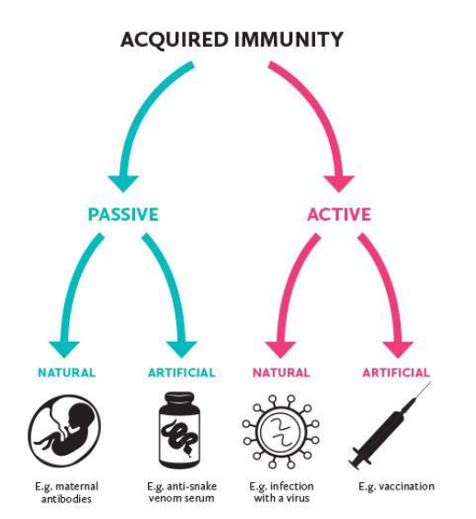

Types of Specific (Acquired) Immunity

Slide 2
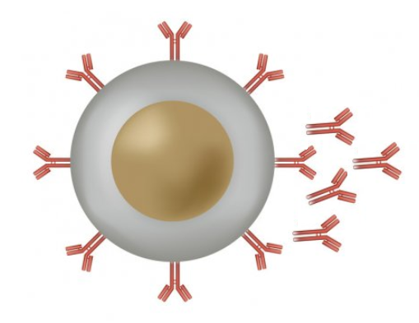



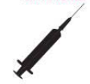

Active vs Passive Immunity
ACTIVE
Exposure to antigen causes body to actively produce immunity
sensitisation of lymphocytes, producing cell mediated and antibody mediated immunity.
memory cells.
Eg: When a virus naturally enters your body, your body actively fights it off via the process above.
Eg: When you get a vaccine, your body actively produces antibody via the process above
PASSIVE
Body gets “ready made” antibody from another source – does not need to actively work to produce the antibody.
Antibody received neutralises any pathogens present but will be used up.
No memory cells produced
Eg: Antibody produced by the mother passes through the placenta and breast milk to the baby
Eg: Snake antivenom is bottled antibody that is injected into the blood to neutralise venom

Slide 3


Natural vs Artifical Immunity
NATURAL
Immunity develops via natural processes in the human body.
Eg: When a virus naturally enters your body, your body actively fights it off via cell-mediated and anti-body mediated immunity.
Eg: Antibody naturally produced by the body are passed from mother to baby via the placenta and breast milk so that the baby becomes temporarily, passively immune.
ARTIFICAL
Scientific processes are used to create immunity.
Eg: vaccines are developed to produce active immunity without illness.
Eg: Snake antivenom is produced so that antibodies to the venom can be injected into a person bitten by a snake to neutralise the venom.

Slide 4
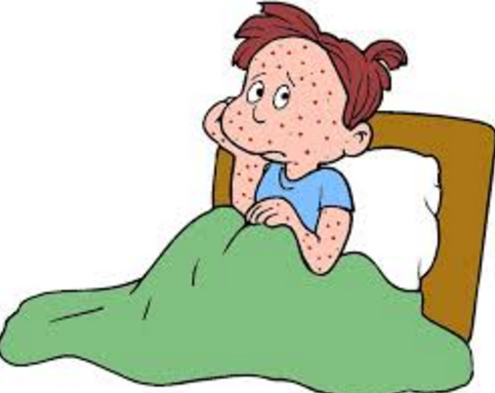
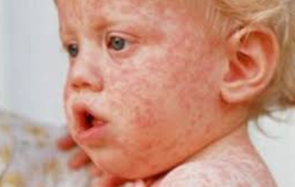
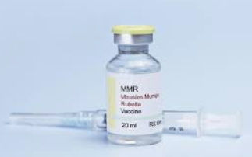
Example: Active Natural Immunity
Eg: Getting the Measles
If someone is exposed to the Measles virus, their immune system responds.
B-cells and T-cells (lymphocytes) become sensitised
produce antibody to fight the virus
Produce memory cells specific to the virus so next encounter will be neutralised before symptoms develop

Slide 5
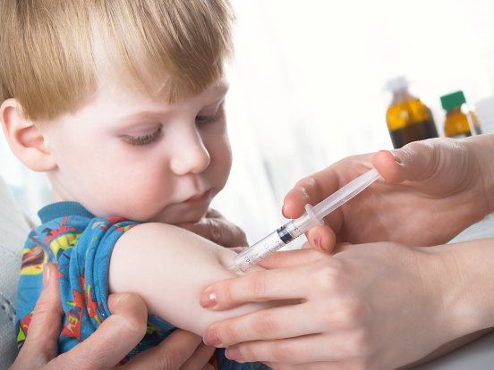
Example: Active Artificial Immunity
Receiving a Measles Vaccine
A vaccine is given, containing either killed measles virus, substances that mimic the measles antigen, or a very mild form of the virus
B-cells become sensitised
Antibody produced
Memory cells produced
Immunity to measles results.

Slide 6
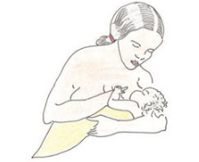
Example: Passive Natural Immunity
Eg: antibody transfer from mother to child via breastfeeding or across placenta
Antibodies from mother’s bloodstream are transferred to baby during gestation or nursing.
Baby then has circulating antibody to neutralise specific pathogen.
Doesn’t last – no active response from baby’s immune system, no memory-cells produced.

Slide 7
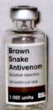
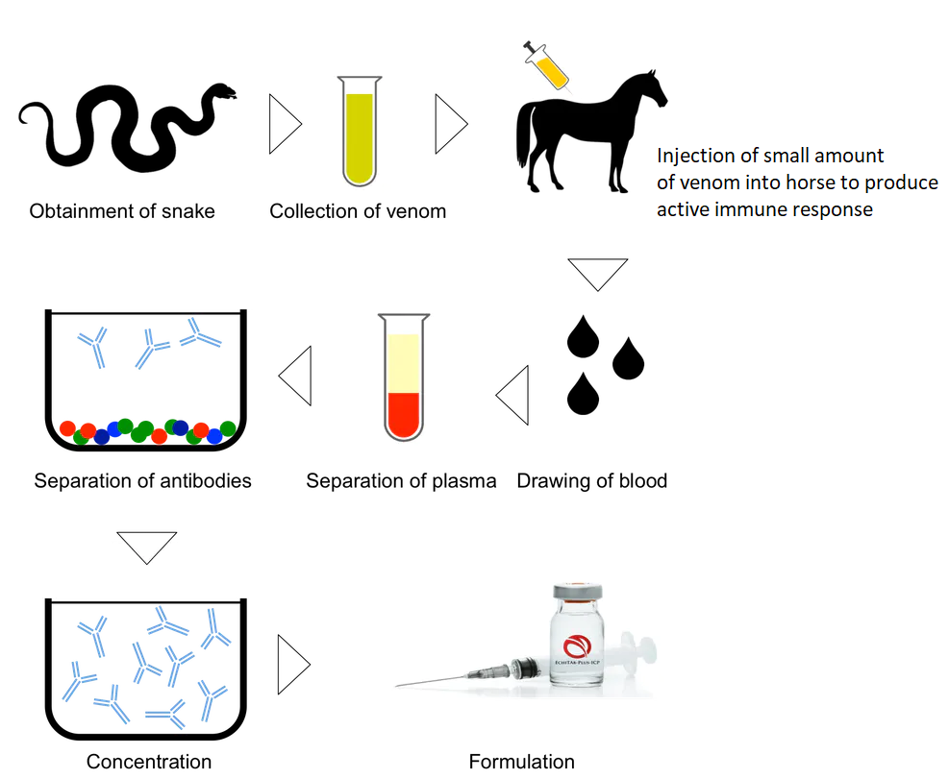
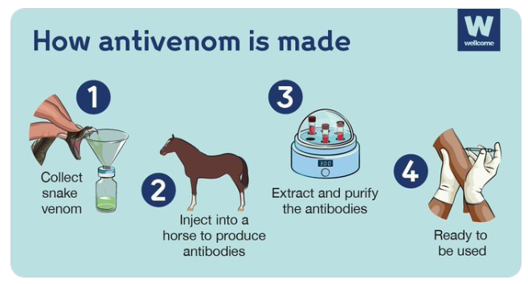
Example: Passive Acquired Immunity
Eg: administration of snakebite antivenom
Antibodies to snake venom produced in a laboratory
Injected into patient’s bloodstream:
Antibody neutralises venom
Short term only – no memory-cells produced

